Slide 1

TECHNO INDIA NJR INSTITUTE OF TECHNOLOGY
Project Presentation

Slide 2
TEAM DETAILS
Name – Akhilesh Joshi Branch - Computer Science Engineering Roll no. – 18ETCCS005
Name – Yash Joshi
Branch – Computer Science Engineering
Roll no. – 18ETCCS098

Slide 3
Face Mask Detection using Python
Our Project is based on Face Mask Detector which scans for masks on face to use in real-time applications which require face-mask detection for safety purposes due to the outbreak of Covid-19 and Swine-Flu. The System is implemented using Python Modules.
The scope of the project is to scan for people without masks so that they can be fined or impose a penalty for doing soo. Further this can be used in a variety of situations to ensure the maximum precaution from different diseases. This project can be integrated with embedded systems for application in airports, railway stations, offices, schools and public places to ensure that public safety guidelines are followed.

Slide 4
METHODOLODY
DATASET COLLECTION:
Images from various sources are used to build a dataset.
The size of datasets can be expanded by the application of data enhancement techniques.
The photographs are stored in two files, “training dataset” and “test dataset” each of which comprises 80 and 20% of the images, respectively.
IMAGE ENHANCEMENT:
To draw attention to the foreground elements, the image is improved through preprocessing methods and segmentation techniques.
MODEL IMPLEMENTATION:
The face mask detector didn’t use any morphed masked images dataset.
The model is accurate, and since the MobileNetV2 architecture is used, it’s also computationally efficient and thus making it easier to deploy the model to embedded systems (Raspberry Pi, Google Coral, etc.)

Slide 5
APPLICATIONS AND FUTURE SCOPE OF PROJECT:
APPLICATIONS:
Covid-19 Pandemic
Check Individuals And Crowds Wearing Masks In Public
Alert Staff When No Masks Are Detected
Railway Stations, Airports
Banks, School and Colleges

Slide 6
Future Scope
Firstly, the proposed technique can be integrated into any high-resolution video surveillance devices and not limited to mask detection only.
Secondly, the model can be extended to detect facial landmarks with a facemask for biometric purposes.
Our proposed system can detect and recognize human faces in the real-time world.
Our future aim is to create face mask recognition datasets with different mask wearing states, or employ zero shot learning to make the design identify erroneous mask wearing states.

Slide 7
Dependencies of Project
SOFTWARE REQUIREMENTS:
Back end technologies : Python 3.9
Python Modules: Keras, Tensorflow, MobileNet and OpenCV
IDE : PyCharm
Database : Datasets
HARDWARE REQUIREMENTS:
Local, development, User acceptance test (UAT) environment
RAM - Minimum 8 GB
CPU - i5 processor
Disk Space- 50 GB
Production Environment
Resource (RAM, CPU, Disk) requirement depends upon user load

Slide 8
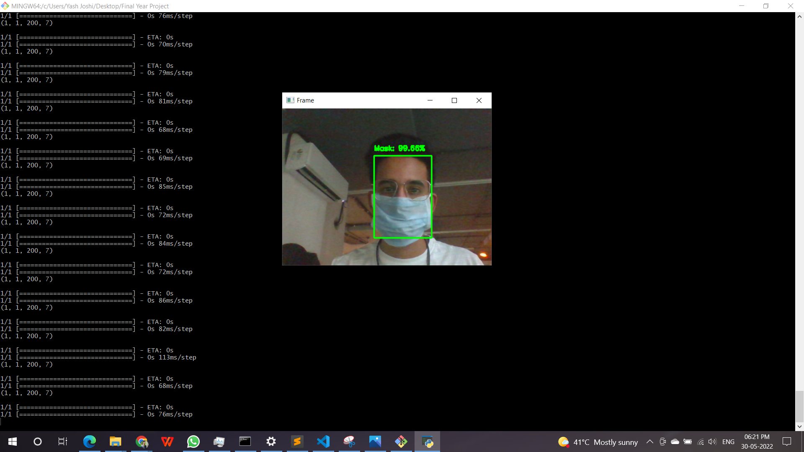
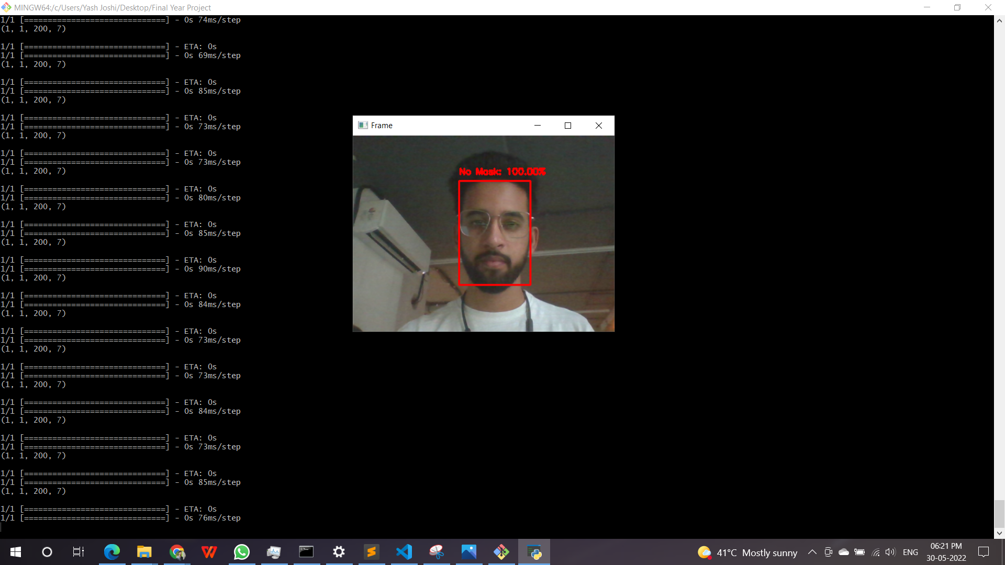
SCREENSHOTS

Slide 9
Thank you

